Slide 1

Lo-Fi Prototype Grapes

Slide 2


Feedback from previous meeting
As John described, the goal for this application is to avoid duplicates. Moreover, the call center should not be eliminated from the process of hamper ordering. The only concern to be addressed is reducing the call volume hopefully with this upcoming application.
In addition, John would like the Link2Feed software to be incorporated with our upcoming application.

Slide 3
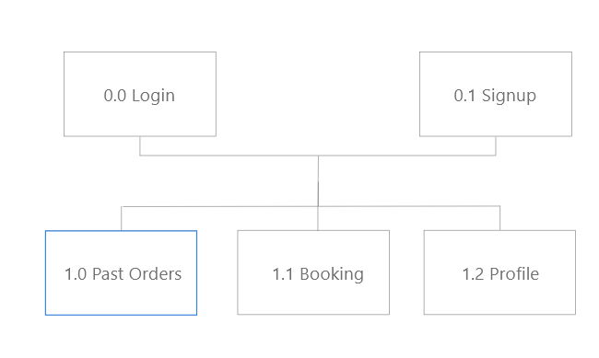
Site map
One can either sign-up or login to access the booking functionality

Slide 4
Lo-fi sketches

Slide 5
Questions
How exactly do you want the L2F software to work with the application?
After reviewing the illustrations of the site, do you have any inquiries?
Is it possible to get an overview or image of how the L2F software works?

